Slide 1
The Cyber 7even’s Presentation on Programming
Programming with Python

Slide 2
The main difference between algorithm and pseudocode
The main difference between algorithm and pseudocode is that an algorithm is a step by step procedure to solve a given problem while a pseudocode is a method of writing an algorithm.
An algorithm is a procedure for solving a problem. In other words, it is a sequence of steps to solve a given problem. It can contain sequences, iterations, selection, etc. Usually, there can be several methods to solve a problem.
It is important to analyze each solution and select the best approach to solving it. On the other hand, a pseudocode is a method of developing an algorithm.
Programmers can use informal simple language to write a pseudocode and there is no strict syntax to follow. It is a text-based detailed design tool.

Slide 3
For example, when the user wants to login to a Facebook account, first he has to go to Facebook.com. Then he has to give the correct username and password. Then he has to click the login button. If the username and password are correct, the user can enter his account. Likewise, every problem has a sequence of steps to solve it.
Example to add two numbers:
Declare variable ( Two variable to store the number input by the user and one variable is used to store the output).
Take the input of two numbers.
Apply the formula for addition.
Add two numbers.
Store the result in a variable.
Print the result.

Slide 4
Pseudocode is an informal way of writing a program. It is not exactly a computer program. It represents the algorithm of the program in natural language and mathematical notations. Usually, there is no particular code syntax to write a pseudocode. Therefore, there is no strict syntax as a usual programming language. It uses simple English language.
Pseudocode to add 2 numbers is as follows;
Sum Of Two Numbers()
Begin
Set sum=0;
Read: num1, num2;
Set sum = num1+num2;
Print sum;
End

Slide 5
Pseudocode to find the area of a Rectangle is as follows.
Area Of Rectangle()
Begin
Read: width, length;
Set area = width * length;
Print area;
End

Slide 6
Pseudocode of sequential flow with multiple alternatives is as follows.
Display Values()
Begin
Read: x;
if x==1 then
Print: “One”;
else if x==2 then
Print: “Two”;
else
Print: “x is not 1 or 2”;
EndifEnd

Slide 7
Pseudocode to print 5 numbers is as follows.
Print One To Five()
Begin
Set i=1;
while i<=5
Print : i;
Set i= i+1;
endwhile
End

Slide 8
Distinguish between programs, programming and programmers
What is a program?
A program is a specific set of ordered operations for a computer to perform. Programs, also called an application or software, is a set of instructions that process input, manipulate data, and output a result. For example, Microsoft Word is a word processing program that allows users to create and write documents.
What is programming?
Computer programming is the process of writing code to facilitate specific actions in a computer, application or software program, and instructs them on how to perform.
Who is a Programmer?
Programmers use programming languages to write, test, and maintain code. These essential tech professionals to create programs and software that millions of people use every day.Computer programmers work independently as part of larger software teams. Together with software developers and engineers, programmers create the instructions computers use to execute tasks. A programmer's job also includes finding bugs, eliminating errors, and troubleshooting issues. These professionals need a detail-oriented and creative outlook, along with skills in several programming languages. As people and organizations rely more on technology, computer programmers can find work across industries. Use our guide to explore this dynamic profession, including key skills, job outlook, and career paths for computer programmers.

Slide 9
Construct an algorithm using real world scenarios
Algorithm: for login into Face book account
Login to face book account:
Step 1: Open the App or open app on your browser
Step 2: Open App
Step 3: Read sign in necessary details for app to accept you
Step 4: click login to account button to start
Step 5: Conformation that login information is correct user can enter his/her account
Step 6: User can access account

Slide 10
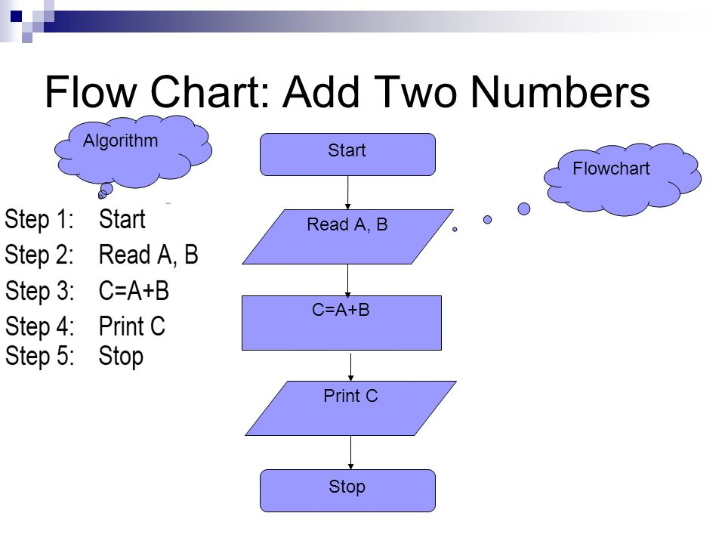
Create flowcharts (sequential) to solve basic problems

Slide 11
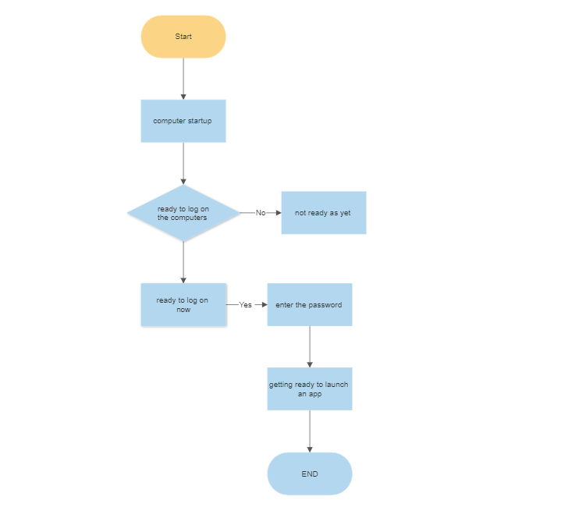
Flow Chart: signing into a computer

Slide 12
Distinguish between variables and constants
A variable is a named location used to store data in the memory. It is helpful to think of variables as a container that holds data which can be changed later throughout programming.
Eg: Number= 10
A constant is a type of variable whose value cannot be changed. It is helpful to think of constants as containers that hold information which cannot be changed later.
Non technically, you can think of constant as a bag to store some books and those books cannot be replaced once placed inside the bag.

Slide 13
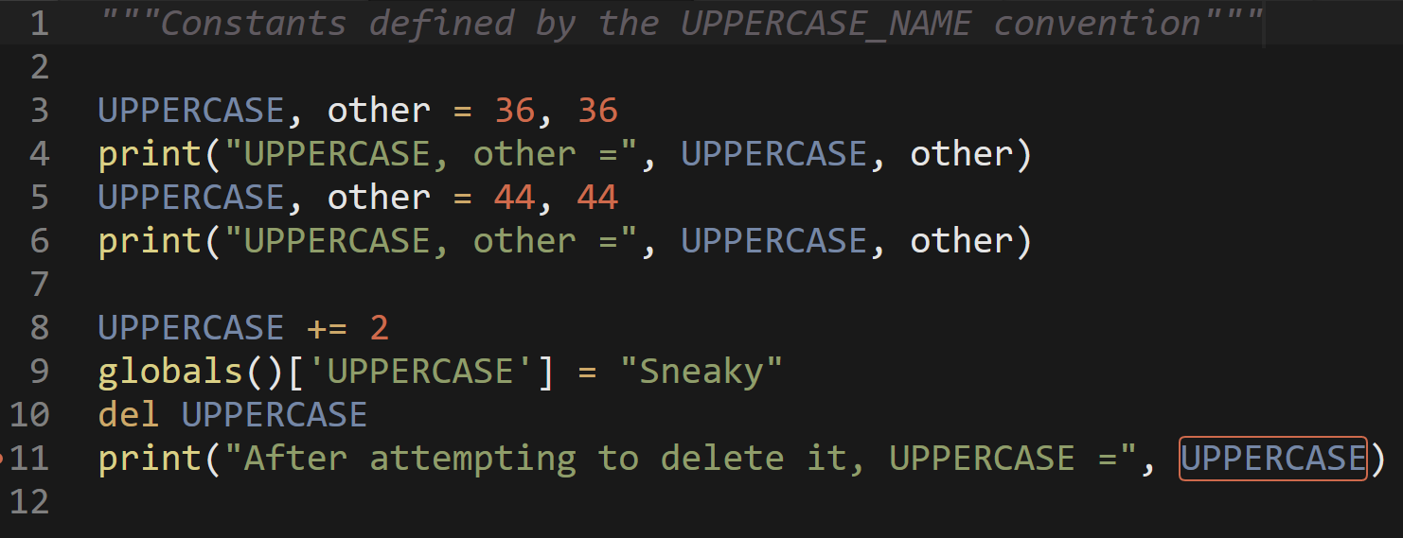
As it relates to assigning a value to a constant in Python, constants are usually declared and assigned on a module. Here, the module means a new file containing variables, functions etc which is imported to main file. Inside the module, constants are written in all capital letters and underscores separating the words.

Slide 14
Demonstrate an understanding of the rules to be followed when naming identifiers.
What is an identifier ?
A Python identifier is a name used to identify a variable, function, class, module or other object. An identifier starts with a letter A to Z or a to z or an underscore (_) followed by zero or more letters, underscores and digits (0 to 9).
Python does not allow punctuation characters such as @, $, and % within identifiers. Python is a case sensitive programming language. Thus, Supercomputer and supercomputer are two different identifiers in Python.

Slide 15
Rules for writing Identifiers in Python
The identifier is a combination of character digits and underscore and the character includes letters in lowercase (a-z), letters in uppercase (A-Z), digits (0-9), and an underscore (_).
An identifier cannot begin with a digit. If an identifier starts with a digit, it will give a Syntax error.
In Python, keywords are the reserved names that are built-in to Python, so a keyword cannot be used as an identifier - they have a special meaning and we cannot use them as identifier names.
Special symbols like !, @, #, $, %, etc. are not allowed in identifiers.
Python identifiers cannot only contain digits.
There is no restriction on the length of identifiers.
Identifier names are case-sensitive.

Slide 16
Recommend appropriate data types that should be used to store given data.
In Python, there are several built-in data types that you can use to store values in your programs. Here is a list of the most common data types in Python:
Integers: These are whole numbers that can be positive, negative, or zero. For example: 42, -23, 0.
Floating-point numbers: These are numbers with decimal points. For example: 3.14, -9.81, 0.0.
Strings: These are sequences of characters, represented with quotes. You can use single quotes or double quotes to define a string. For example: 'hello', "world", "123".
Booleans: These are True/False values. They are commonly used in control statements to check if a condition is True or False. For example: True, False.
Lists: These are ordered sequences of values that can be of any data type. Lists are defined using square brackets and commas. For example: [1, 2, 3], ['apple', 'banana', 'cherry'], [True, False, True].
Tuples: These are also ordered sequences of values, but they are immutable (i.e., they cannot be modified). Tuples are defined using parentheses and commas. For example: (1, 2, 3), ('apple', 'banana', 'cherry'), (True, False, True).
Sets: These are unordered collections of unique values. Sets are defined using curly braces and commas. For example: {1, 2, 3}, {'apple', 'banana', 'cherry'}, {True, False}.
Dictionaries: These are unordered collections of key-value pairs. Dictionaries are defined using curly braces and colons. For example: {'name': 'Alice', 'age': 25}, {1: 'apple', 2: 'banana', 3: 'cherry'}, {True: 'Yes', False: 'No'}.

Slide 17
Distinguish between operators and operands
In a computer program or mathematical expression, an operator is a symbol that performs a specific operation on one or more operands. Operands are the values or variables that the operator is applied to.
For example, in the expression "5 + 3", the "+" symbol is the operator performing the addition operation. The operands in this expression are 5 and 3.
In general, operators can be classified into different categories based on the number of operands they require. Unary operators operate on a single operand, binary operators operate on two operands, and ternary operators operate on three operands.
Here are some examples of operators and operands:
In the expression "5 + 3", the "+" symbol is the operator and 5 and 3 are the operands.
In the expression "x * y", the "*" symbol is the operator and x and y are the operands.
In the expression "abs(-5)", the "abs" function is the operator and -5 is the operand.
In the expression "a = b + c", the "=" symbol is the operator and a, b, and c are the operands.

Slide 18
Distinguish between statements and expressions
In programming, a statement is a line of code that performs some action but does not return a value. An expression is a piece of code that returns a value.
For example, in Python:
x = 2 # This is a statement
y = x + 2 # This is an expression that returns a value (4)
Here, the assignment statement x = 2 does not return a value, it simply assigns the value 2 to the variable x. The expression x + 2 returns the value 4.
In most programming languages, statements are terminated with a semicolon (;), while expressions are not. However, this is not a hard and fast rule and can vary depending on the language.

Slide 19
Evaluate expressions accurately
In Python, you can use the eval() function to evaluate an expression and get its result.
Given that it enables you to run any legitimate Python expression, the eval() method is incredibly strong. If you use it to assess user-provided input, though, it might also pose a security issue because it might enable malevolent individuals to run arbitrary code on your system. If you need to evaluate user-provided input, it is typically advised to use safer alternatives, such as the ast.literal eval() function.

Slide 20
Expressions accurately given in arithmetic form
Expressions only contain identifiers, literals and operators, where operators include
arithmetic and boolean operators, the function call operator () the subscription operator [] and
similar, and can be reduced to some kind of &quot;value&quot;, which can be any Python object.
Examples:
3 + 5
map(lambda x: x*x, range(10))
[a.x for a in some_iterable]
yield 7
Statements (see 1, 2), on the other hand, are everything that can make up a line (or several
lines) of Python code. Note that expressions are statements as well.

Slide 21
Expressions accurately given in arithmetic form con’t
# all the above expressions
print 42
if x: do_y()
return
a = 7

Slide 22
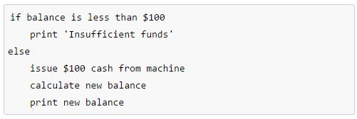
Simple sequential statement using pseudocode
Let’s say we wanted a program for the ATM to check the customer's balance and determine if there is enough money in the account to make a withdraw of $100 cash.

Slide 23

THE END

